Slide 1
Mobile-Commerce Development
Lesson
Activity and Intent
Lecturer:
Tran Duy Thanh, Phd
Nguyen Quang Phuc, Msc
Email: thanhtd@uel.edu.vn
Blog: https://tranduythanh.com
Phone: 0987773061

Slide 2
Lesson Objective
- Students understand Activity and Activity lifecycle states
- Use Intent to open Activities
- Know how to transfer data back and forth between Activities
- Can use some Implicit Intents, such as Dial Up, Direct Call

Slide 3
Outlines
Activity
Intent
Transfer data between Activities
Implicit intent

Slide 4
1. Activity
In an application there can be many Activities, each Activity can be understood as an application screen.
Each Activity will have its own life cycle completely independent of other Activities.
Each Activity called in the application must be declared in the Manifest.

Slide 5
1. Activity
Activity Stack
New Activity
Running Activity
New Activity started
Back Button pushed or Running Activity closed
Last Running Activity
Activity n-1
. . .
Activity Stack
Activity 3
Previous activities
Removed to free resources
Activity 2
Activity 1

Slide 6
1. Activity
Activity launched
Activity Lifecycle
onCreate()
User navigates to the activity
onStart()
onRestart()
App process killed
onResume()
Activity running
User returns to the activity
Apps with higher priority need memory
onPause()
User navigates to the activity
onStop()
The activity is no longer visible
Another activity comes into the foreground
onDestroy()
The activity is finishing or being destroyed by the system
Activity shutdown

Slide 7
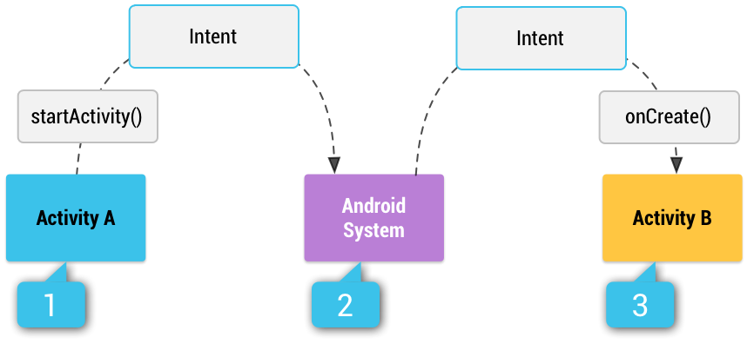
2. Intent
Intent is used to convey a message, requesting an action from the called component.
Intent is used in three main cases:
Start the Activity through the startActivity method.
Start the Service through the startService method.
Pass the message to the BroadcastReceiver via the sendBroadcast method.

Slide 8
2. Intent
Intent is divided into two types:
Explicit Intent: clearly specifies the processing component through the class name, often used to call components in the same application.
Implicit Intent: does not specify the processing component, instead adds attributes such as action description, data type...

Slide 9
2. Intent
Explicit Intent:
Declare:
Intent intent = new Intent(this, <Component>);
Example: Start an Activity named SecondActivity from MainActivity
Intent intent = new Intent(MainActivty.this, SecondActivity.class);
startActivity(intent);

Slide 10
3. Intent
Implicit Intent:
Declare:
Intent intent = new Intent(this, <Action>);
Example: Start the Activity to make a phone call
Intent intent = new Intent(Intent.ACTION_CALL);
startActivity(intent);

Slide 11
3. Transfer data between Activities
Open another activity
FIRST ACTIVITY
SECOND ACTIVITY
Open second activity
Activity open with an Intent

Slide 12
3. Transfer data between Activities
Open another activity
Intent intent = new Intent(MainActivty.this, SecondActivity.class);
startActivity(intent);

Slide 13


3. Transfer data between Activities
Open another activity and send data
FIRST ACTIVITY
SECOND ACTIVITY
Intent
{action + data}
Open second activity
Activity open with an Intent
Package from the first activity

Slide 14
3. Transfer data between Activities
Open another activity and send data
There are two ways to send data to Intent:
Direct:
Use the putExtra(Key, Value) method to set directly to the Intent
Through Bundle
Create a Bundle object, use the set<KDL>(Key, Value) method on the Bundle object
Use the putExtras() method to send the Bundle to the Intent.
FIRST ACTIVITY
Open second activity

Slide 15
3. Transfer data between Activities
Open another activity and send data
For example, send the integer X into the Intent
Direct:
intent.putExtra("X", x);
Through Bundle:
Bundle bundle = new Bundle();
bundle.putInt("X", x);
intent.putExtras(bundle);
FIRST ACTIVITY
Open second activity

Slide 16
3. Transfer data between Activities
Open another activity and send data
Retrieve data directly Extras:
Use the get<KDL>Extra(Key, DefaultValue) method to retrieve Intent data.
Using Bundle
Use the getExtras() method to retrieve the Bundle object in the Intent.
Use the get<KDL>(Key, DefaultValue) method to retrieve data in the Bundle.
SECOND ACTIVITY
Activity open with an Intent

Slide 17
3. Transfer data between Activities
Open another activity and send data
For example, retrieve the integer sent in the Intent
Direct:
Intent intent = getIntent();
int soNguyenX = intent.getIntExtra("X", 0);
Through Bundle:
Intent intent = getIntent();
Bundle bundle = intent.getExtras();
int soNguyenX = bundle.getInt("X", 0);
SECOND ACTIVITY
Activity open with an Intent

Slide 18
3. Transfer data between Activities
Open another activity: send data and receive data
Activity #1
Activity #2
startActivityForResult
Intent
. . .
. . .
{ action + data + requestCodeId }
onActivityForResult()
onResult()
. . .
{ requestCodeId + resultCode, optional data }
. . .
. . .
. . .

Slide 19
3. Transfer data between Activities
Open another activity: send data and receive data
Sending and responding to Intent in Activity is divided into 3 steps:
Step 1: Send Intent through the startActivityForResult() method including 2 parameters:
Intent: Data needs to be sent for processing.
requestCode: Code that requires processing from the sending side.
Step 2: Receive and process the Intent, then validate the response via the setResult() method in the response app component.
Initialize the Intent object, set the necessary properties: action, category...
Send response data directly to the Intent or through the Bundle variable.
Call the setResult method with the Intent parameter.
Step 3: Call the onActivityResult() method to retrieve three parameters:
requestCode: request code that resolves with the corresponding intent.
resultCode: result code received from the response side.
Intent: data received from the response side.

Slide 20
3. Transfer data between Activities
Open another activity: send data and receive data
startActivtyForResult(intent)
getIntent()
setResult(intent)
onActivityResult(intent)
SendActivity
requestCode
ReceiveActivity
resultCode

Slide 21
3. Transfer data between Activities
FirstActivity
SecondActivity
Step 1:
Step 2:
startActivityForResult
(intent,113);
intent=getIntent()
setResult(115,intent);
finish();
Step 3:
onActivityResult(
int requestCode,
int resultCode,
Intent data)

Slide 22
4. Implicit Intent
Call Action makes a phone call
//Make a dial
//Intent intent = new Intent(Intent.ACTION_DIAL);
//Make a phone call
Intent intent = new Intent(Intent.ACTION_CALL); Uri uri = Uri.parse("tel:" + edtPhone.getText().toString()); intent.setData(uri); startActivity(intent);
<uses-permission android:name="android.permission.CALL_PHONE"/>

Slide 23
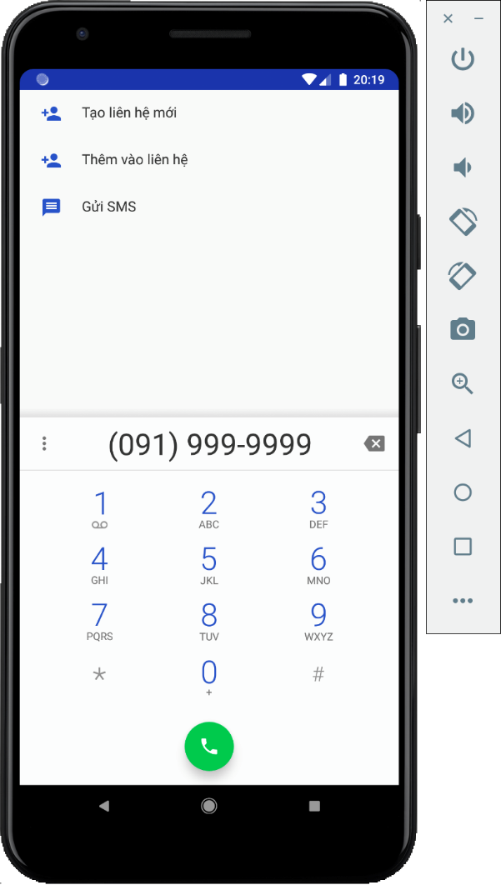
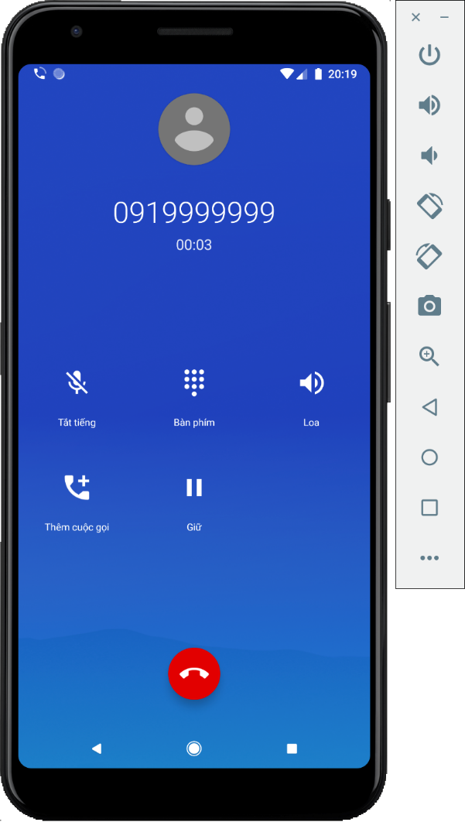
4. Implicit Intent
Call Action makes a phone call
ACTION_DIAL
ACTION_CALL

Slide 24
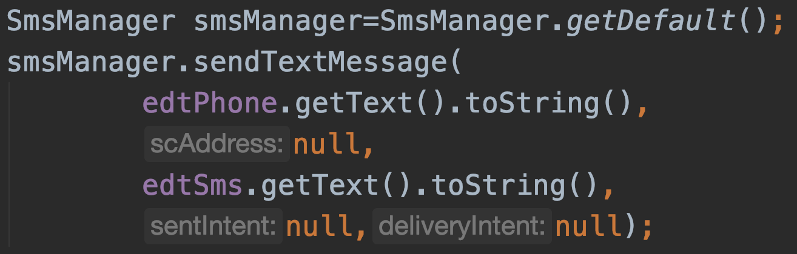
4. Implicit Intent
Send SMS
<uses-permission android:name="android.permission.SEND_SMS"/>

Slide 25
4. Implicit Intent
Send SMS and check Result
SmsManager smsManager=SmsManager.getDefault(); Intent msgSent=new Intent("ACTION_MSG_SENT"); PendingIntent pendingMsgSent = PendingIntent.getBroadcast(MainActivity.this,0,msgSent,0); registerReceiver( new BroadcastReceiver() { @Override public void onReceive(Context context, Intent intent) { int kq=getResultCode(); if(kq== Activity.RESULT_OK) // Send SMS successful else // Send SMS failed } }, new IntentFilter("ACTION_MSG_SENT") ); smsManager.sendTextMessage( edtPhone.getText().toString(), null edtSms.getText().toString(), pendingMsgSent,null);

Slide 26
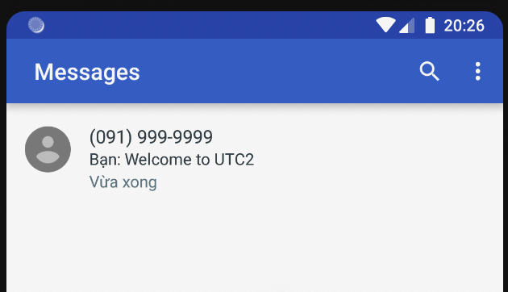
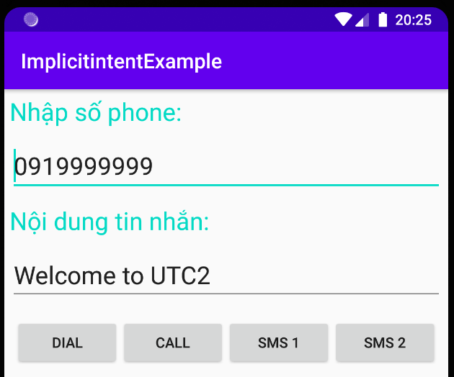


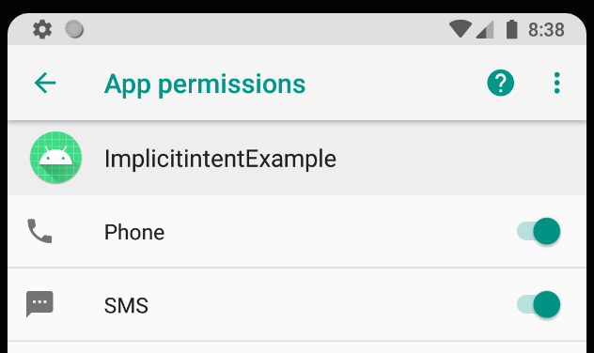
4. Implicit Intent
Send SMS and check Result

Slide 27
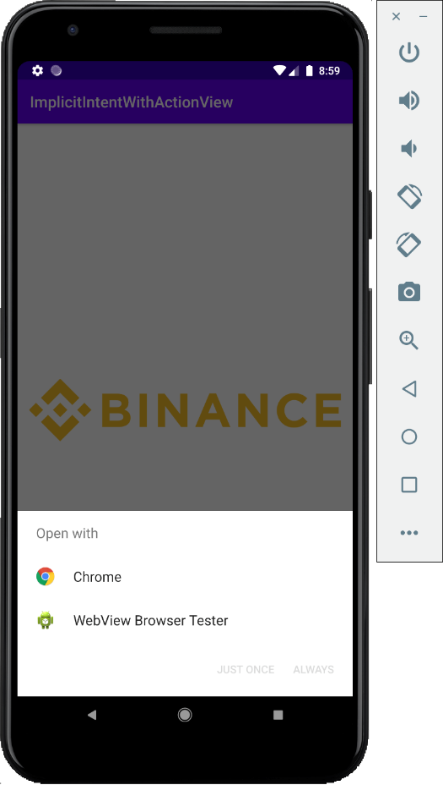
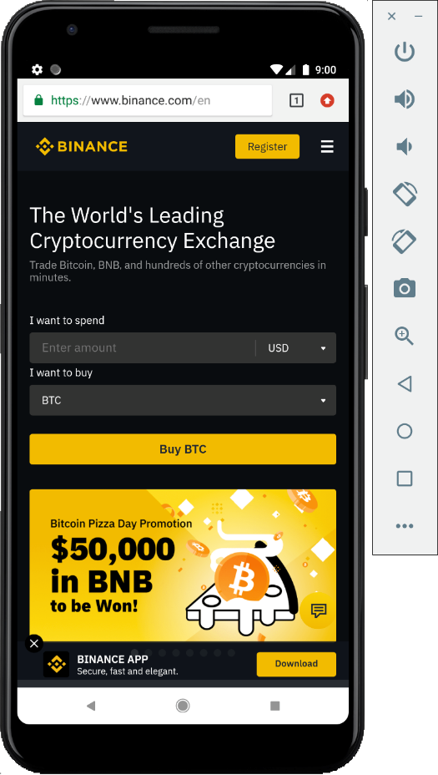
4. Implicit Intent
Implicit intent with ACTION_VIEW
Intent intent = new Intent(); intent.setAction(Intent.ACTION_VIEW); intent.setData(Uri.parse("https://binance.com")); startActivity(intent);

Slide 28
4. Implicit Intent
Implicit intent open Camera
public void openCamera(View view) { Intent intent = new Intent(MediaStore.ACTION_IMAGE_CAPTURE); startActivityForResult(intent, REQUEST_CODE_ID); } @Override protected void onActivityResult(int requestCode, int resultCode, @Nullable Intent data) { super.onActivityResult(requestCode, resultCode, data); if(requestCode == REQUEST_CODE_ID && resultCode == RESULT_OK
&& data != null){ Bitmap bitmap = (Bitmap) data.getExtras().get("data"); imvPhoto.setImageBitmap(bitmap); } }

Slide 29
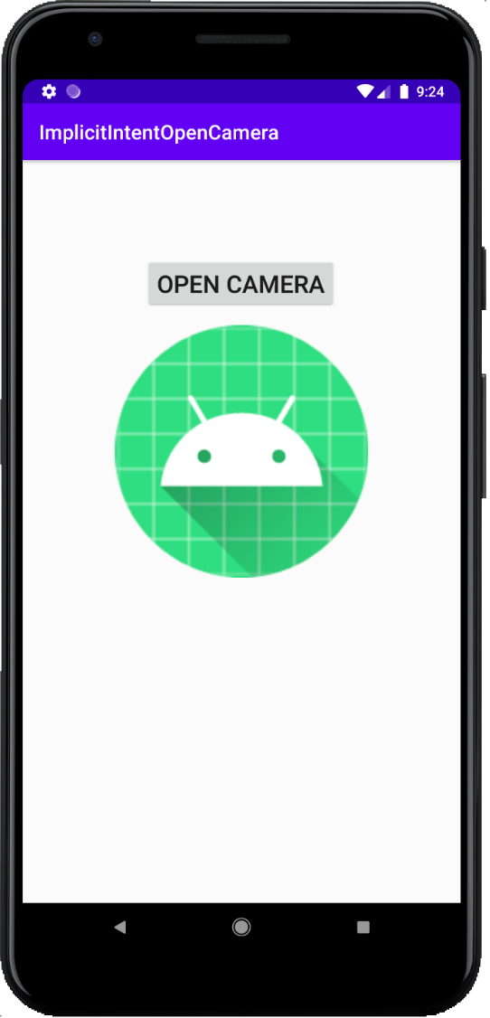
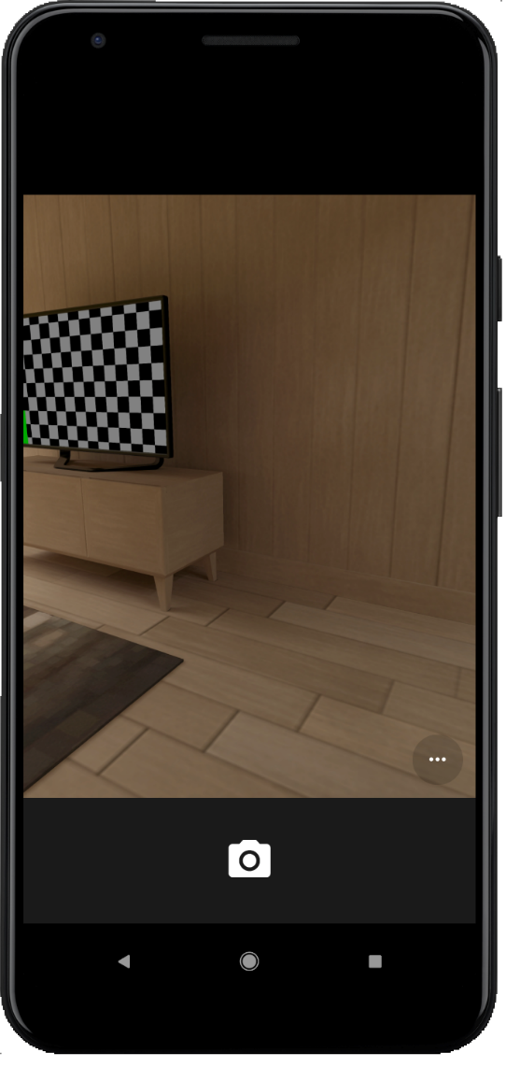
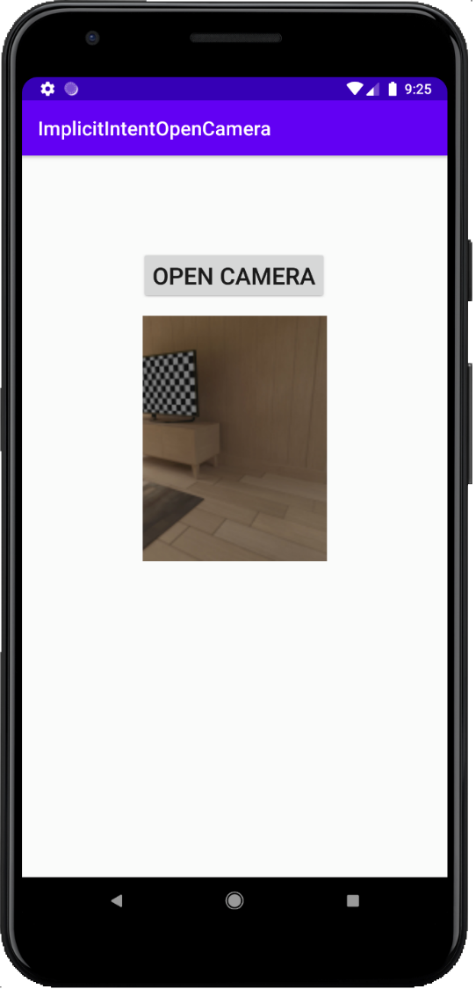
4. Implicit Intent
Implicit intent open Camera

Slide 30
Discussions
Q1: Present the life cycle of Activity
Q2: Show how to open an Activity
Q3: Show how to open an Activity and pass data to this Activity
Q4: Show how to open an Activity and listen for the returned results
Q5: Compare the difference between Explicit Intent and Implicit Intent
Q6: Demonstrate how to use Implicit Intent to make phone calls, text messages, take photos, and get images from SD Card

Slide 31
Next Lesson
Fragment

Slide 32
THANK YOU!

